Slide 1
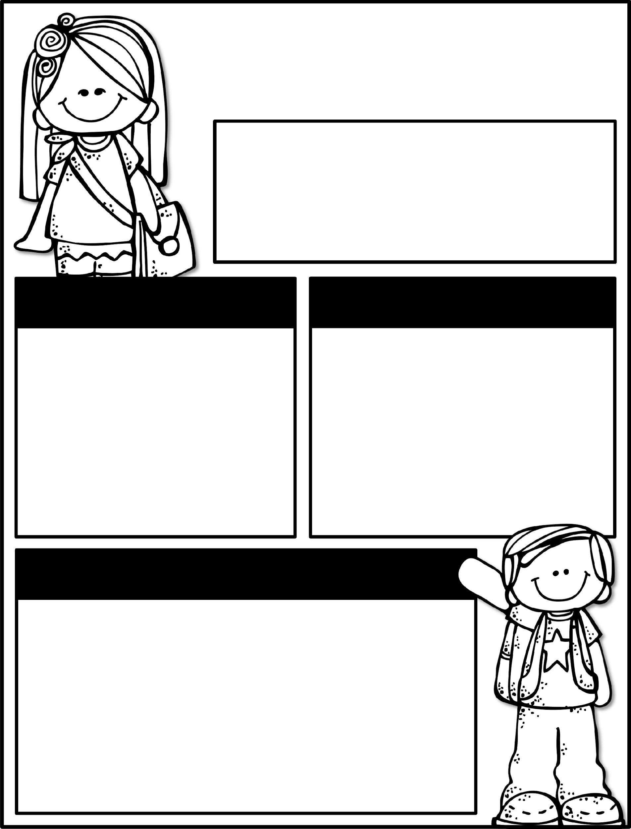

Kindergarten News
September 30- October 4,, 2024
Class News
Learning Focus
We are so glad that everyone is safe and sound after the severe weather that came through due to the hurricane!
Timeline projects will be presented this week in class so please make sure you get yours turned in. This week is also career week and we are looking forward to seeing all the fun ideas you dress up as for the different days listed under our upcoming events section.
Upcoming Events
Learning Focus
9/30 Timeline Project Due
9/30 Career Week Starts
  Monday- Wear clothes to represent a possible future career
  Tuesday- Dress to Impress (interview clothes)
  Wednesday- Wear a jersey or team shirt
  Thursday- No dress up
  Friday- Wear yellow
10/3 Fun “Thursday”
10/10 Talent Show @ 6:30pm
10/11 Early Release - dismissal @ 11:15
10/17 50th day of School
Birthdays
Liam 10/12
Ember 10/24
Reading: Asking and answering questions about key details, characters, and setting
Writing: Narrative text
Math: Patterns
Phonics: Letters / Letter sounds
Social Studies: Day/Week/Month and Past/Present/Future
Sight Words to practice
a, the, as, to, do, I, is, am, at, an, man, in, it, was, you
Contact Me:
Email: olivia.otis@henry.k12.ga.us
School Phone Number: 770-898-7362
Reminders
Please check your child’s binder each night. Check Dojo each night.
Ask questions if you have them!
Please send a water bottle and daily snack for your child.
Please keep a change of clothing in your child’s bookbag .
We have completed the GKIDS assessments. This measures what your child knows entering kindergarten. Your child’s report will be his/her first report 9-week report card.

